Slide 1
BV 204 - Implementing SharePoint
Failure to Plan is Planning to Fail

Slide 2
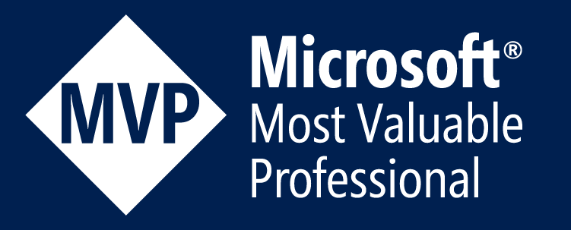


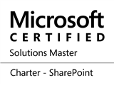
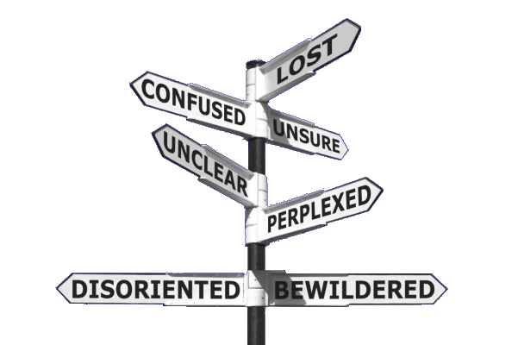

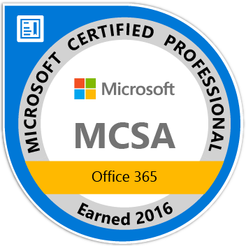

Paul Papanek Stork
Owner/Principal Architect
Don’t Pa..Panic Consulting
Author
Developer’s Guide to WSS 3.0
MOSS 2007 Best Practices
MCTS: WSS 3.0 Configuration Study Guide (70-631)
SharePoint 2010 Development for Office 365
Microsoft Community Contributor
    Technet Forums
    MSDN Forums
    Yammer Groups
Contact Information
Email:
pstork@att.net
Blog:
http://dontPaPanic.com/blog
Twitter:
@PStork
Notes:
Principal SharePoint Architect for BlueChip Consulting Group
http://www.bluechip-llc.com
SharePoint MVP for 9 years
SharePoint Microsoft Certified Master
Author
Developer’s Guide to WSS 3.0
MOSS 2007 Best Practices
MCTS: WSS 3.0 Configuration Study Guide (70-631)
SharePoint 2010 Development for Office 365
Contact Information
Email: Paul.Stork@bluechip-llc.com
Blog: http://dontPaPanic.com/blog
Twitter: @PStork

Slide 3
Agenda
Why Companies don’t Plan SharePoint Implementations
7 Essential Planning Areas
  Governance – Having a common strategic vision
  Security – Balancing security concerns with corporate culture
  Information Architecture – How will you find things
  Physical and Logical Architecture – Limit costs and improve performance
  High Availability/Disaster Recovery – Planning for a business critical resource
  Staffing - Even self-service systems need support
  Training/Communications – Users must be informed to be empowered

Slide 4
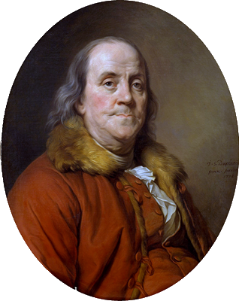
Why Plan?
If you fail to plan,
you are planning to fail!
- Benjamin Franklin

Slide 5
Why Don’t Companies Plan?
Typical Reasons
“We don’t know enough about the capabilities of SharePoint. We need to do a pilot to find out what’s possible.”
“People are excited now about the new environment. If we spend a lot of time planning that enthusiasm will wane.”
“Planning is important, but we don’t want to succumb to Analysis-Paralysis. We’re afraid that planning will just go on forever and we’ll never implement anything.”
“We hired a consulting firm to do our implementation. They are experts, have done this before, and already know how it should be done.”
“We’re just doing an upgrade. We did our planning when we originally implemented SharePoint.”

Slide 6
Why Planning Is Still Needed
Pilots often become production when you aren’t looking
Nothing dampens enthusiasm like a system that doesn’t meet user’s business needs
Proper planning avoids Analysis-Paralysis
Every Implementation needs to be adapted to local needs
Upgrades need to account for changes and new feature sets

Slide 7
7 Essential Planning Areas

Slide 8
Governance
Goal: Reach consensus on rules of the road and a shared strategic vision
Recruit a broad based governance committee
Key Questions
  How self-service oriented is our corporate culture?
  What will be controlled by policy rather than customization?
  What business needs will SharePoint address?
  How will policies be communicated and updated?
SharePoint Governance
Information Architecture
Operational Management
Infrastructure
Testing & Provisioning
Development & Configuration
Education & Training
Taxonomy & Navigation
Enterprise Search

Slide 9

Security
Goal: Decide how security will be administered
Centralized vs. Delegated
  Centralized – AD Groups
  Delegated – Site Collection Administrators
Tradeoffs to consider
  Content ownership vs content management
  Timely access vs. Security
  Training requirements
Centralized
Delegated

Slide 10
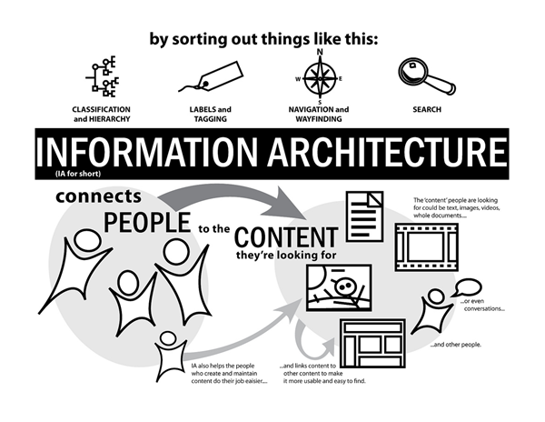
Information Architecture
Goal: Plan how content will be organized to make it easy to find
Taxonomy
  Site Hierarchy, templates, global navigation
  Managed Metadata for tagging
Folksonomy
  Social tagging, Enterprise keywords
  Communitity

Slide 11
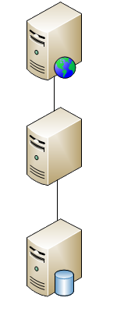
Logical and Physical Architecture
Goal: Maximize Performance while Minimizing Costs
Don’t just throw hardware at the problem
Locate services in appropriate places
How heavily will search be used? How big a Corpus?
Hierarchy should be defined to avoid duplication, but provide easy access and security

Slide 12

High Availability/Disaster Recovery
Goal: Be able to depend on SharePoint as a Business Critical Application
Understand the difference between
  Recovery point objective (RPO)
  Recovery time objective (RTO)
What are SharePoint’s SLAs?
  How much downtime can we tolerate?
  How much data can we afford to lose?

Slide 13

Staffing
Goal: Plan adequate staffing levels to support SharePoint
Self-Service systems reduce staffing needs
Decisions in other areas may affect staffing
  Centralized Security – Higher
  Information Architecture – Maintenance/Enhancement over time
  Patching Levels – All CUs or just Service Packs

Slide 14

Training/Communications
Goal: Increase User Adoption
SharePoint is NOT intuitive
Develop/leverage local champions
Communicate to employees why SharePoint will…
  Make your company more competitive
  Make their work more productive and easier
Don’t Stop Communicating

Slide 15
Additional resources
Governance planning in SharePoint 2013
https://technet.microsoft.com/en-us/library/ff598584.aspx
6 Tips For Building a Great SharePoint Information Architecture
http://en.share-gate.com/blog/building-a-good-information-architecture-in-sharepoint
Create a communication plan for the upgrade to SharePoint 2013
https://technet.microsoft.com/en-us/library/cc263345.aspx
Determining Your SharePoint Architecture: Centralized Or Decentralized?
http://www.ecmconnection.com/doc/determining-your-sharepoint-architecture-0001

Slide 16
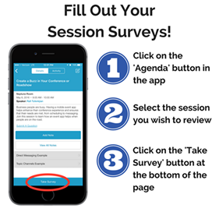
Questions?
Contact Information
  Email: Paul.Stork@dontpapanic.com
  Blog: http://dontPaPanic.com/blog
  Twitter: @PStork

